Slide 1


Who am I?
Network Security research project
Jay Lohokare
Revati Damle
Nittin Aggarwal

Slide 2

Search engines are ubiquitous today – 3.5 billion searches per day (Averaging to 0.5 per person)
Scale and features come at hidden costs – Targeted advertisements
New and innovative ways for data capture and advertisements

Slide 3
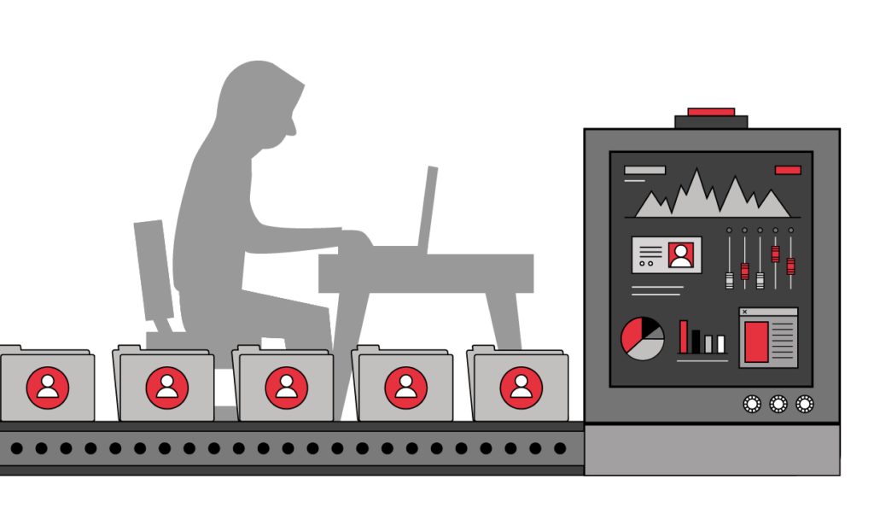
Data is bread and butter for internet companies – No absolute way to protect your data
We explore how Search engines exploit user data and use it for advertisements

Slide 4


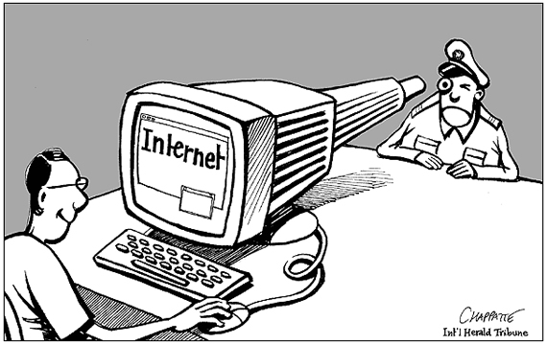
Privacy is growing concern these days
We present a tool to achieve complete privacy with search engines that try to capture data
Primary aim – Prevent search engines from profiling you

Slide 5

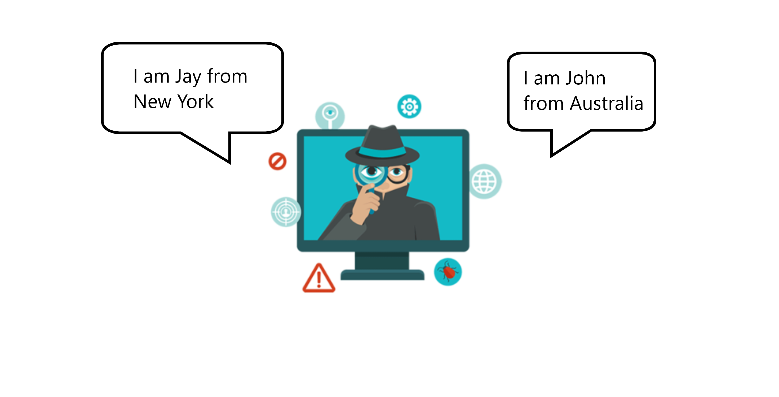

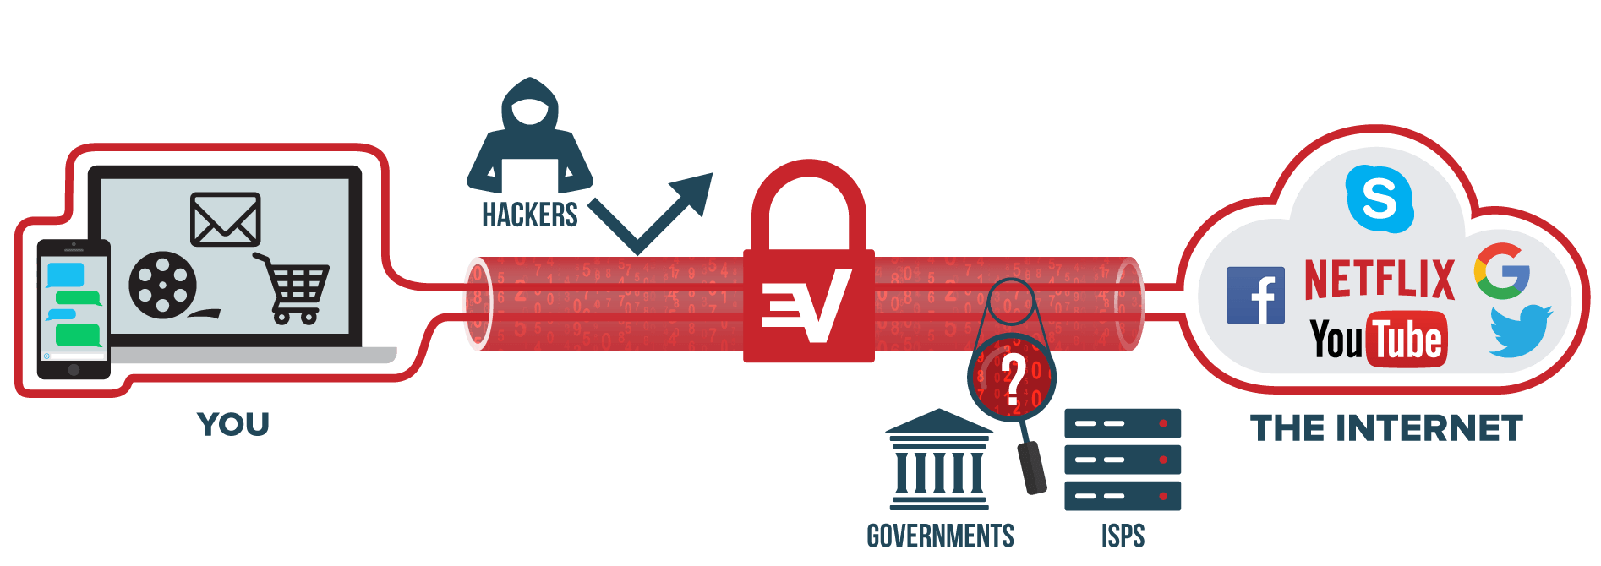
Search engines are aggressive with data capture and profiling
At user end, 3 ways to deal with data privacy -
1. Deal with causes (Prevent data capture)
2. Block outcomes of data capture
3. Share random data

Slide 6
Solution
The tool we have built combines all of these methods to some extent, to achieve anonymity
The primary data points used to profile users are
User IP (Location, browser information)
User cookies (Search history, browsing history)
Service usage history (Usage history for the particular service)
Thus, to achieve anonymity, 3 things need to be achieve:
IP masking
Cookie masking
Query masking

Slide 7

IP Masking
Hide Identity, Geography
Prevent Website Tracking
Overcome internet censorship

Slide 8
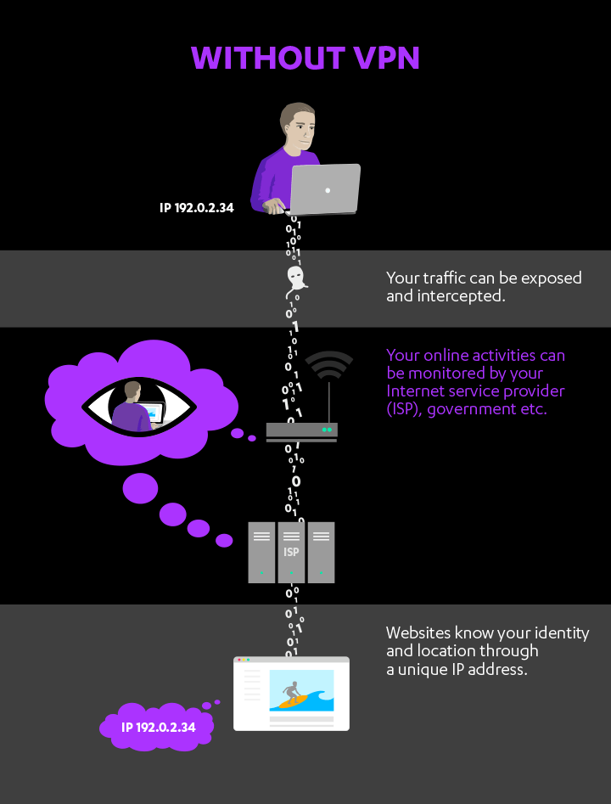
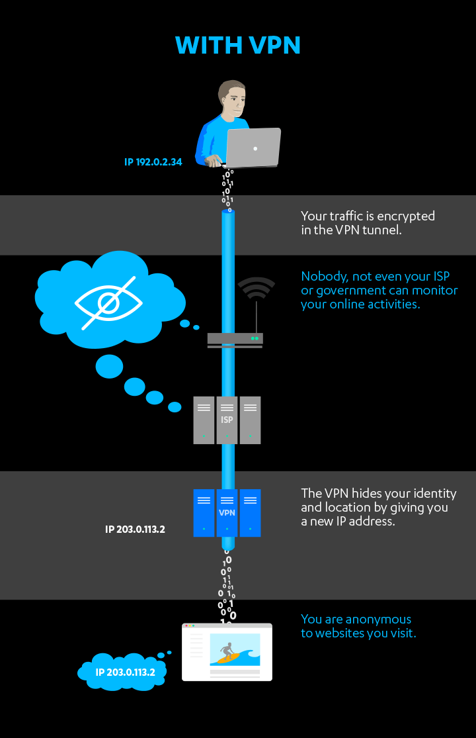

Slide 9
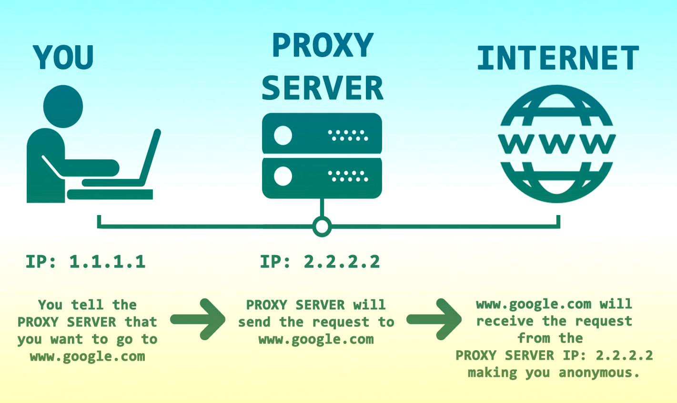

IP Masking - Approaches
VPN
-connect to a different network
-receive IP address from a VPN provider
-traffic routes from VPN network
Proxy Server
-relay your traffic back and forth through a proxy server
-Can bypass blocked sites too!

Slide 10
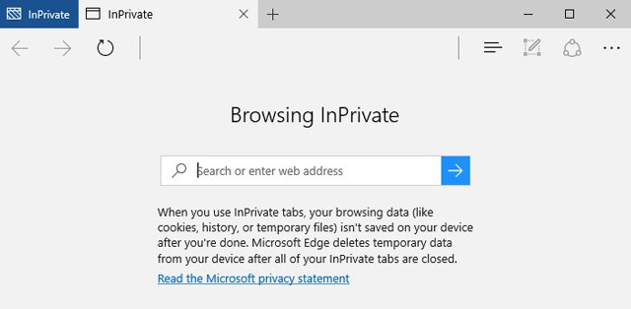
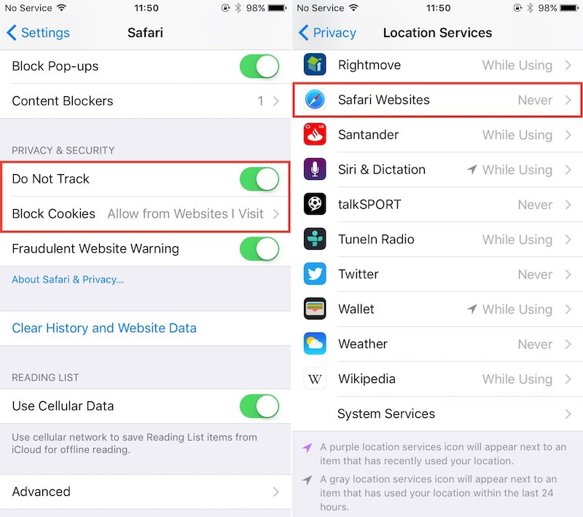
Cookie Masking
What info is exposed via cookie?
Authentication
Site preferences
Shopping cart info in shopping websites
Session tracking info
What can be done ?
-Disable third party cookies
-Private browsing mode
-Do not track header or use TPLs

Slide 11
What else need to be done as we are still not safe!
Disable Ad personalization
- Might use Google analytics browser add on to stop Google from using data to target ads.
May use tools such as Ghostery to evade tracking cookies
Might require to disable geographical sharing (default is Yes)
Root cause :
- sharing simple piece of text with the server while communication that was stored on client or some other machine
What if we can remove the header itself ?

Slide 12
Query Masking
The search queries of the user are used to build a web profile on her.
Query masking techniques:
Confuse the search engine with other related random queries (Machine Learning)
Generate a similar query using Machine translation, hiding persona details

Slide 13

Machine Learning Approach
- Part-of-speech tagging is the most basic syntactic analysis we can do.
Input - A sequence of tokens (e.g., sentence, search queries)
Output - An assignment of POS tags for each word in the input.
- Using word-to-vec embeddings, replace the sensitive words with the most similar ones from the corpora.
- Thus, we can create multiple queries which are similar in semantics but are able to confuse the search engine.

Slide 14
Deep Learning Approach
- Machine translation is the process of translating a sentence from one language to another.
- Here we need to convert a search query from English to another, with similar meaning, hence needing a generalized synthesizer.
- Use a SMT approach, where translations are generated on the basis of statistical statistical models whose parameters are derived from the analysis of bilingual text corpora.
- Limitation : Same language machine translation corpora is not readily available.

Slide 15
Implementation

Slide 16
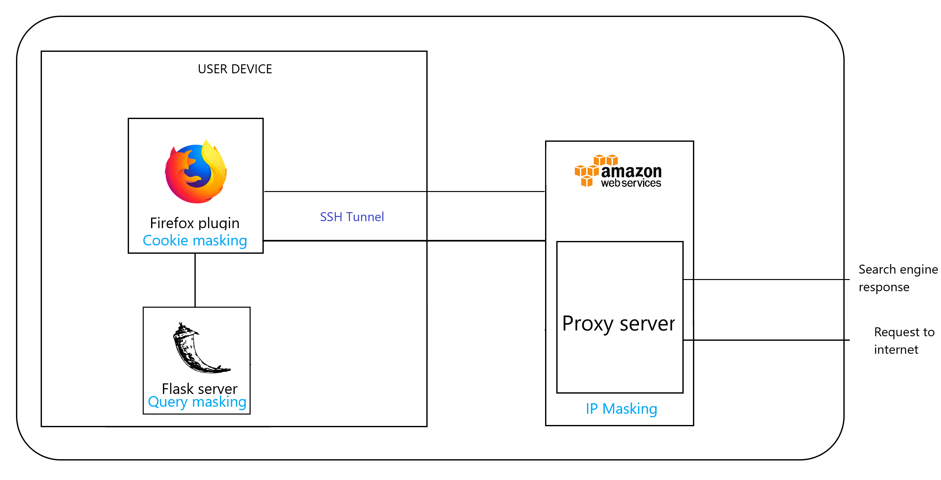
Architecture
High-level system implementation

Slide 17
Query Masking Architecture
POS tagging:
Using spaCy - A free open-source library for NLP in Python. It features NER, POS tagging, dependency parsing, word vectors and more.
Word-to-vec embeddings:
Replace sensitive words like ‘Indian’, ‘today’, ‘NYC’ with words from same category.
Use gensim model : GoogleNews-vectors-negative300.bin , containing 3 million words and phrases that they trained on roughly 100 billion words from a Google News dataset.
 | Indian | restaurants | near | me | today | in | NYC
POS tagging | ADJ | NN | - | - | ADV | - | NN
NER tagging | NOPR | - | - | - | DATE | - | GPE

Slide 18
Examples of related random queries:
Indian restaurants near me today in NYC:
- Pakistani restaurants near me tomorrow in L.A
- Italian restaurants near me yesterday in S.F.
Weather in Stony Brook:
- Weather in S.F
- Weather in Boston

Slide 19
IP Masking & Cookie Masking
Client machine sets up a SSH tunnel with a set of Amazon cloud EC2 instances
Mozilla Plugin selects a proxy out of the set in a round robin fashion to send out web search queries
Uses the proxy as a SOCKS5 host
Port forwarding used to forward traffic to the EC2 instance selected via the tunnel
The search query intercepted by the Mozilla plugin
- It adds the cookie policy to reject all cookies sent by the server

Slide 20
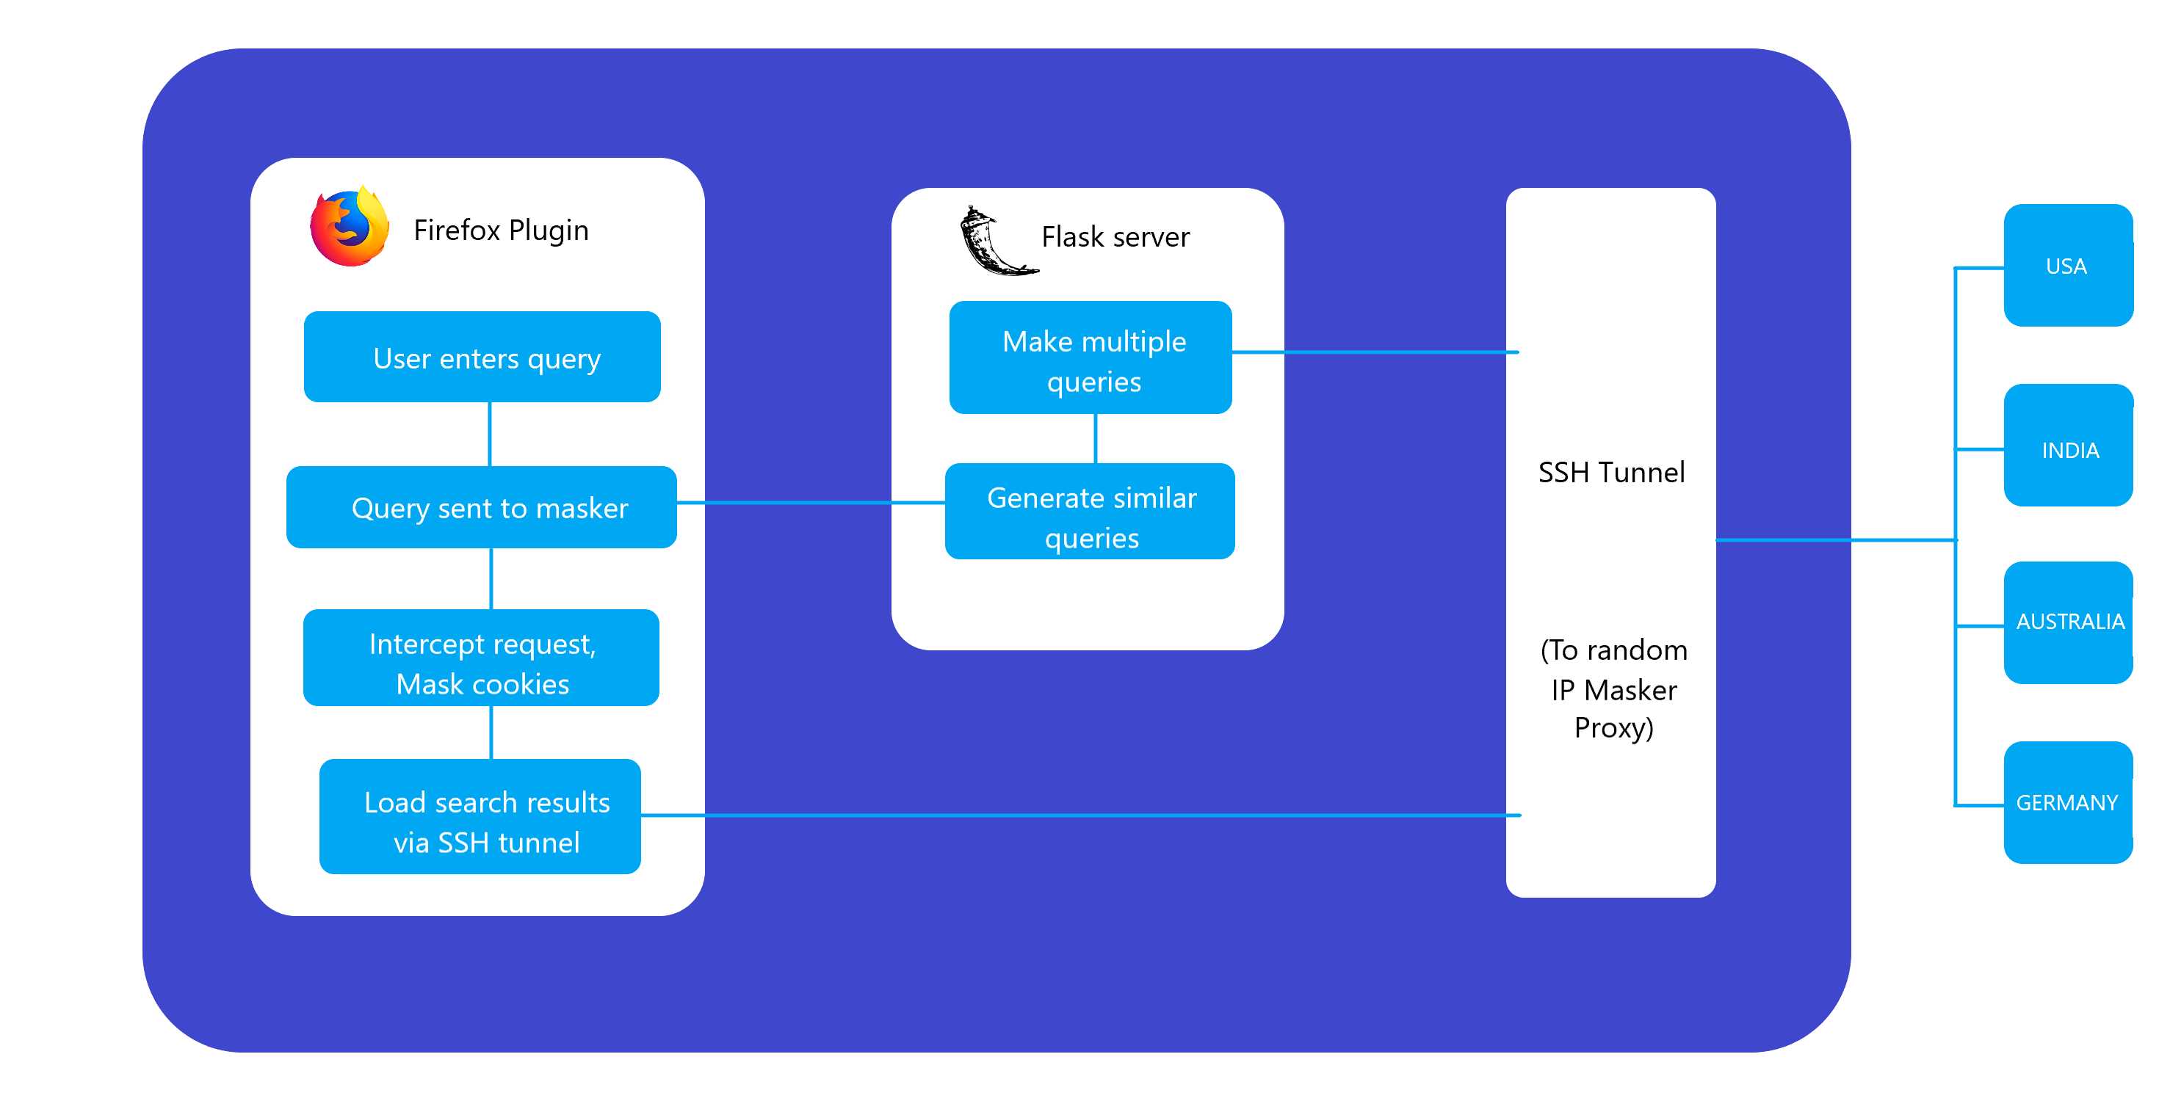
Execution of Search
What happens with every search query

Slide 21
Thank you!

